Slide 1
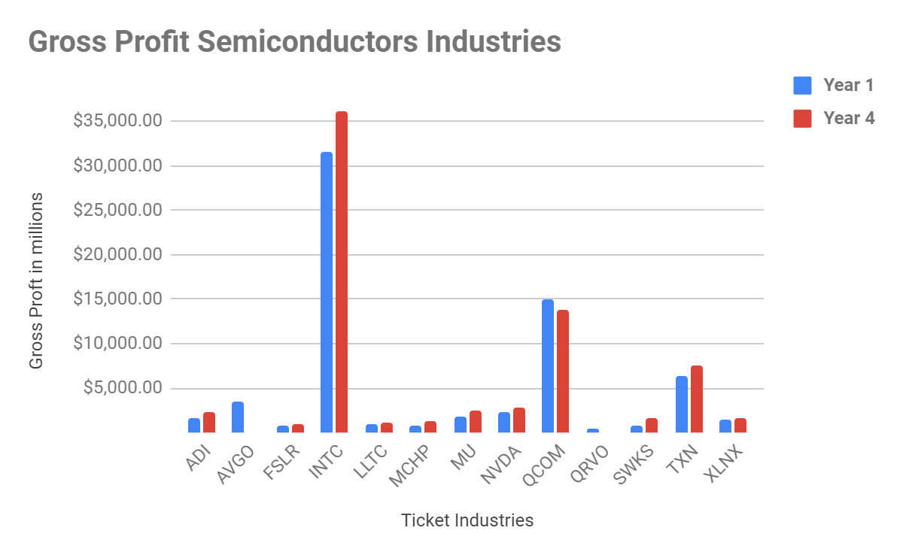
In which year did the INTC semiconductor industry have the highest gross profit between the first and last years?
The bar charts on the left show the Gross Profit (Calculated subtracting Total Revenue from COGS) of all industries in the first and last year. We can see that in both charts the INTC industry is the one with the highest Gross Profit but in the last year they have $4.67B more than the first year. This means that increased 14.8%.
For the Year 1 the SUM of all industries is $67B,507M and the AVG is $5B,193M, for the year 4 the SUM is $71B,511M and the AVG $5B,500M. This indicates that in the last year the Industries had a higher gross profit.
The median in Year 1 ($1B,692M) is $27.2 M higher than year 4 ($1B,665M), this means that in year 1 50% of the companies have a higher gross profit .
The standard deviation in Year 4 ($9B,575M) is $1B,76M higher than year 1 ($8B,479M) this shows that in year 4 was a higher variability of gross profit compared to year 1. The range in year 4 is $5B higher than year 1. It looks like in year 4 have more significant variability and more outliers compared to year 1.
Notes:
Link to spreadsheet
https://docs.google.com/spreadsheets/d/1ts2TNHCsCWNBR6bkbNeJZPY0YsqhMXfam06yzt3bI0g/edit?usp=sharing
The mean for all the semiconductor companies in the first year is around $5B,193M and for the last year is $5B,500M and the difference is $308M. But the median in year 1 is higher ($1B692M) than year 4 ($1B665M). Another fact is that in year 4 the mode is $0 (Because of AVGO and QRVO industries no longer exist)
The standard deviation in year 4 ($9B,575M) is greater than the standard deviation of year 1 ($8B,499M) by $1B,76M. This means that in year 4 the data of the selected range are further from the mean, the range refers to a group of values selected for the analysis and it is obtained subtracting the min value from the max value

